Slide 1
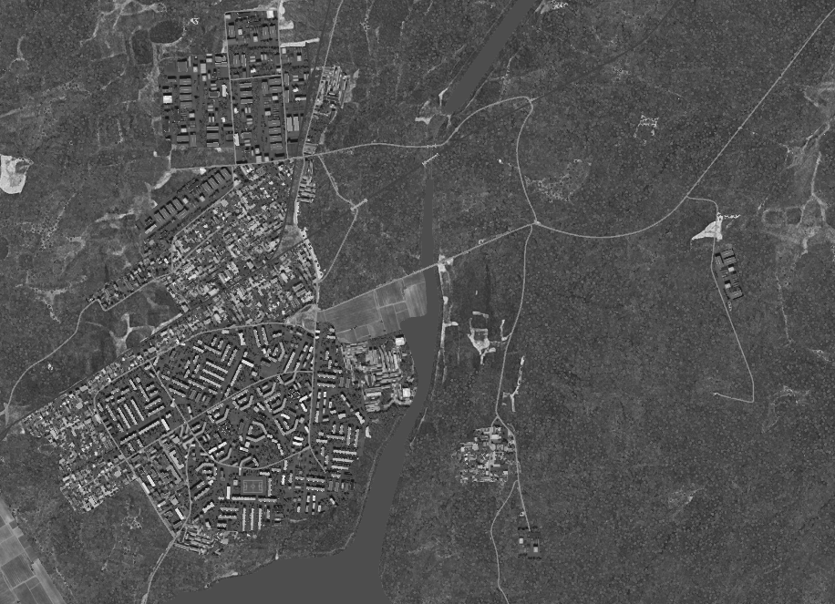
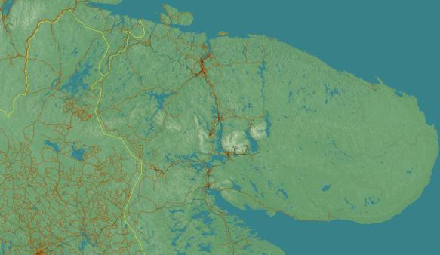
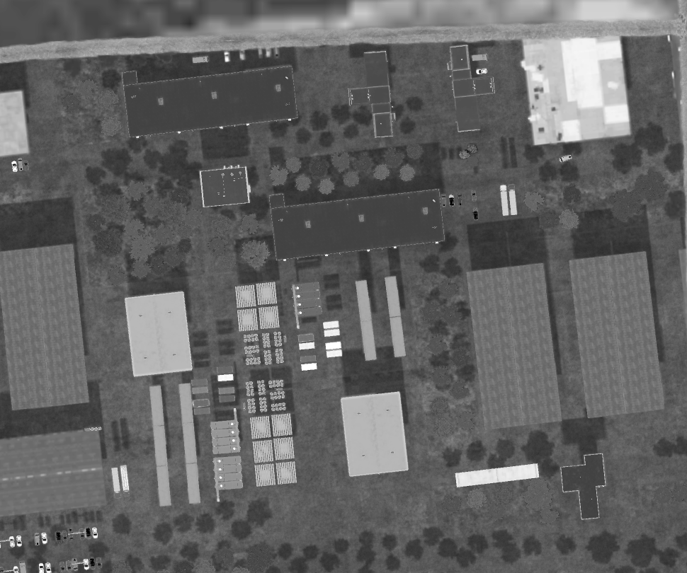


SRNTGT099 Poliarnie Ammunition Factory
N
Poliarnie Ammunition Factory
G
H
99
C
Production Hall (Single level building 1000 lbs)
DPI A N 67 23.210 E 032 30.240 / 434ft DPI B N 67 23.181 E 032 30.344 / 435ft Power to production halls (Single level building 1000 lbs)
DPI C N 67 23.238 E 032 30.290 / 432ft
Chemicals Storage (4-cylinder tank 1000 lbs)
DPI D1 N 67 23.186 E 032 30.264 / 436ft DPI D2 N 67 23.178 E 032 30.264 / 436ft DPI E N 67 23.210 E 032 30.323 / 434ft
Admin building (Single level building 1000 lbs)
DPI F N 67 23.163 E 032 30.451 /
Support to production (single level building 1000 lbs)
DPI G N 67 23.250 E 032 30.380 /
DPI H N 67 23.247 E 032 30.428 /
E
A
B
D
F
TLE CAT 2 – Limit colatoral damage outside of factory boundary

